Slide 1
WEEK 7 PROJECT
Job & Internship
Landing Website
Built with React JS • React Router • Vite • CSS
DG Interns Hub
1

Slide 2
Problem Statement
Why a simple job and internship platform is useful for students
The Challenge
Students often need to search across different sources for internship opportunities.
Important details such as role, location and domain can be difficult to compare quickly.
A clean, focused interface can make opportunity discovery easier.
The project demonstrates how React can be used to build a practical career website.
Project Objective
Create a responsive job and internship landing website.
Provide separate Home, Jobs and Contact pages.
Display opportunities in reusable card components.
Allow users to search, filter and start an application.
2

Slide 3
Key Features
Core functionality implemented in the React application
🏠 Home Page
Hero section, career-focused messaging, features and statistics.
💼 Job Listings
Internship opportunities displayed as reusable cards.
🔎 Search & Filter
Search by title, company, category or location.
🧭 React Routing
Home, Jobs and Contact pages with navigation.
📨 Apply Action
Apply Now button provides an application-start interaction.
📱 Responsive UI
Layout adapts for desktop, tablet and mobile screens.
3

Slide 4
Technology Stack
Tools and concepts used to build the website
1
React JS
Functional components and state management
2
React Router
Client-side navigation between pages
3
Vite
Fast development and production build setup
4
JavaScript
Application logic, filtering and interactions
5
CSS
Custom responsive layout and visual styling
6
GitHub
Source-code version control and deployment workflow
User → React UI → React Router → Components / State → Responsive CSS
4

Slide 5
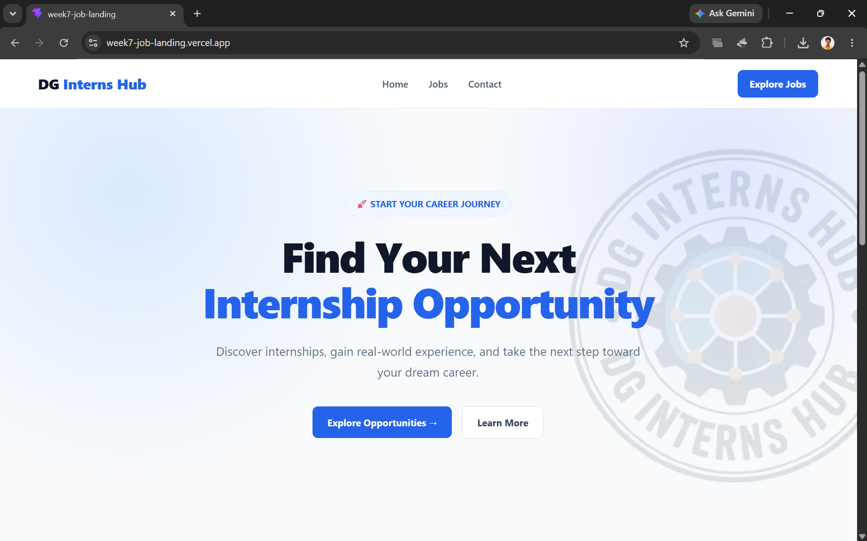
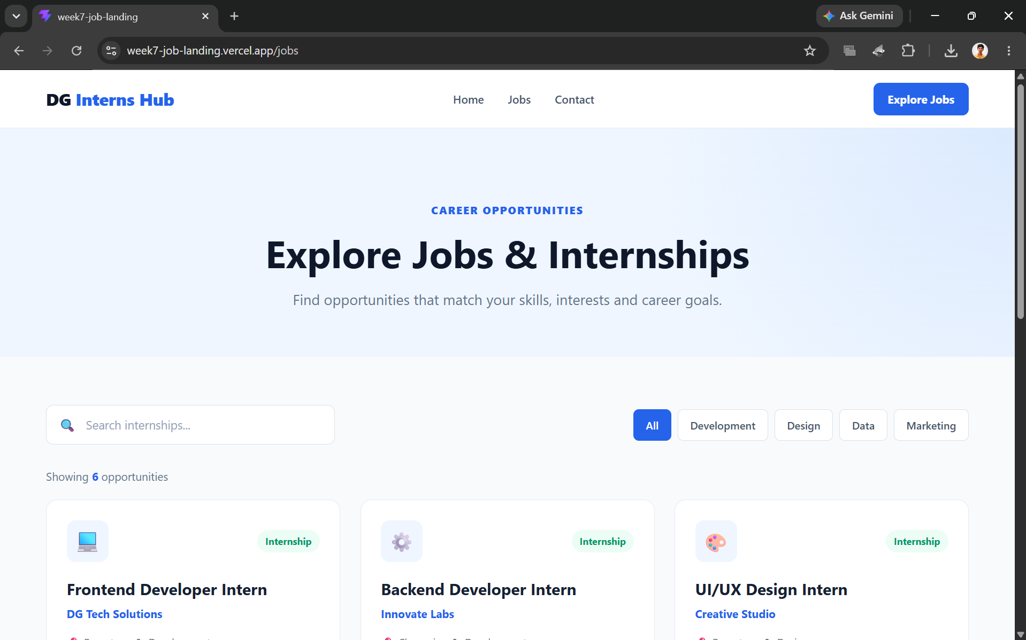
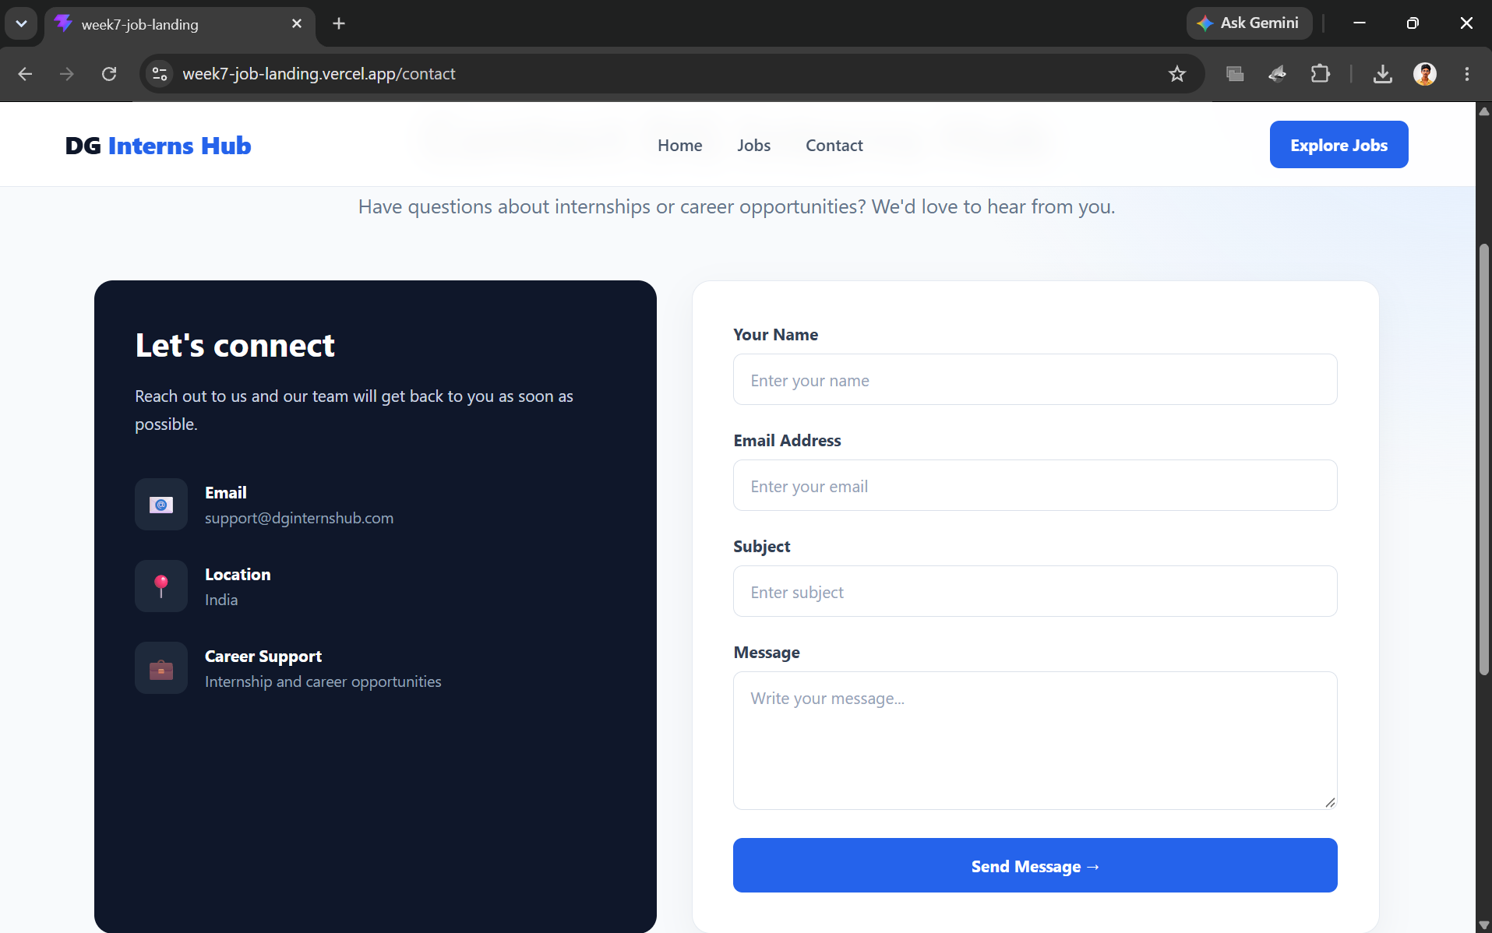
Website Screens
Main pages developed for the Week 7 project
01 Home
02 Jobs
03 Contact
Home
Landing hero • Features • Career statistics
Jobs
Search • Category filters • Job cards • Apply buttons
Contact
Contact information • Message form • Submit action
5

Slide 6
Job Listing & Responsive Design
A practical UI flow for discovering opportunities
1
Open Jobs
2
Search
3
Filter
User navigates to the Jobs page.
Enter a keyword such as React, Python or Data.
Choose Development, Design, Data or Marketing.
4
Review
5
Apply
Compare role, company, location and description.
Select Apply Now to start the application interaction.
Responsive behavior: 3-column cards → 2-column tablet layout → 1-column mobile layout
6

Slide 7
Result & Live Demo
A responsive React-based job and internship landing website
3
6
100%
Main Pages
Sample Listings
Responsive
Home • Jobs • Contact
Development • Design • Data • Marketing
Desktop • Tablet • Mobile
LIVE DEMO FLOW
Home → Jobs → Search / Filter → Apply Now → Contact
Thank You
7

